Slide 1
Title of Symposium Presentation must go here and fit in the box
Presenter Name(s)
Credentials

Slide 2

Required to Use this Template
All speakers MUST use the Title page (slide 1) and the Questions and Evaluation page (slide 13).
It is RECOMMENDED that you use this entire PowerPoint template theme for your PM Symposium presentation.

Slide 3
Dos and Don’t
Presentation Best Practices

Slide 4
DO NOT CREATE IN GOOGLE SLIDES
ONLY the downloaded .pptx provided

Slide 5
Guidelines for Fonts and Sizes
Required Font to use : ARIAL
Font size Minimum: 14pt (Nothing Smaller - Example 14pt)
This font size also applies to the images, charts, or graphs used.
If the font is small in a visual, See next slide for Tips
Try to stick to a Max of 4 bullet points per slide.
Too much text on a slide disengages the audience
ONLY Use Template Bullet Points

Slide 6
Company Branding
Company Brands can only be used in speaker “About Me” pages and the ending “Contact Information” section
Any branded slide decks will be sent back to be redone in the approved Symposium template

Slide 7
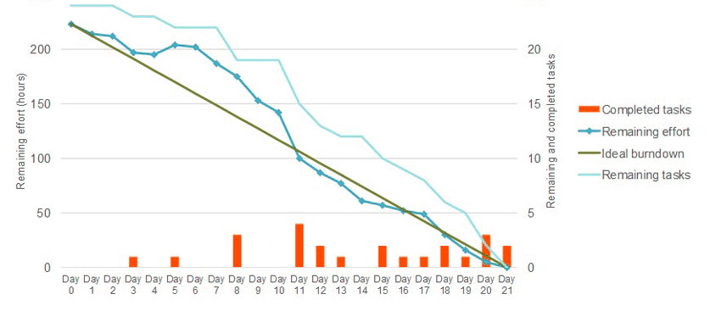
Small Graphic Example
We recommend you show the image then zoom in or outline the part you want to talk about.
Option 2 - pull out the text so the attendees can also read it.
See Next Slide for edits
^ This chart is not able to be read by attendees

Slide 8

Tips for Small Texted Figures
Rewrite Small Text Larger for Learners
Box part of chart you are talking about.
Completed Tasks
Remaining Effort
Ideal Burndown
Remaining Tasks
* Note colors in the chart would not pass the approved color contrast test.
See Next Slide for more

Slide 9
Color Guidelines
Font Colors: Only use Black (#000000) or Red - BOLDED (#e21833).
Color-on-Color Combinations: Acceptable combinations only:
Yellow BOLD (#ffd200) on Black (#000000)
White BOLD (#ffffff) on Dark Red (#e21833)
Red(#e21833) on White (#ffffff)
Black (#000000) on White (#ffffff)
White BOLD (#ffffff) on Black (#000000)

Slide 10
These are the approved colors
Point #1:
These are approved and acceptable color combos
Point #2:
These are approved and acceptable color combos
Point #3:
These are approved and acceptable color combos

Slide 11
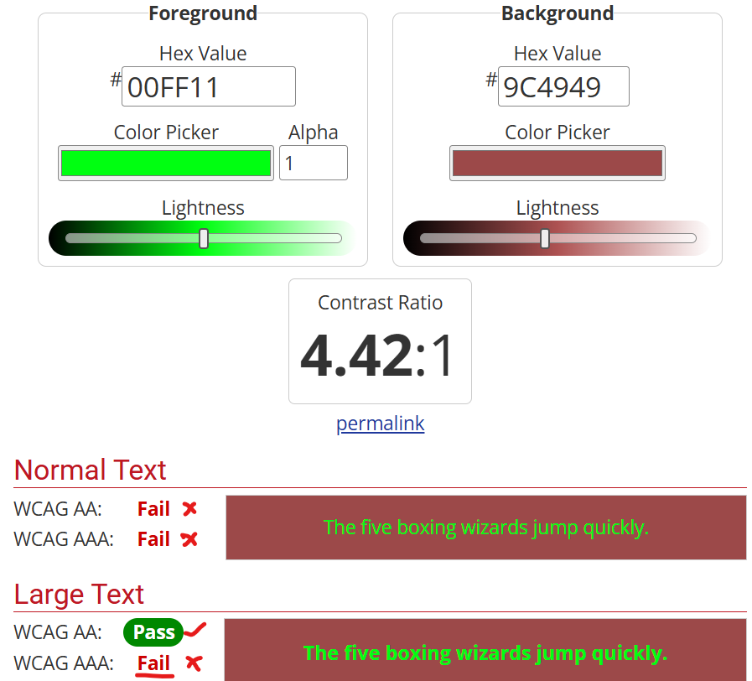
Color Guidelines For Branded Images
There needs to be Contrast between colors in your images.
Anything other than the approved color combo will need to be run through this test.
You can test image Contrast here> https://webaim.org/resources/contrastchecker/
You must have the “Normal Text” Pass

Slide 12
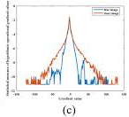
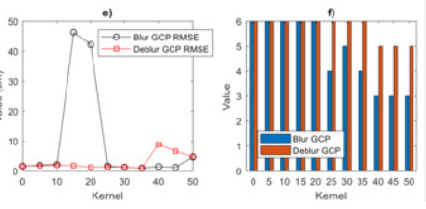
Guidelines for Images
Blurry images will not be accepted.
You will need to recreate them.
A minimum of 1 visual a slide is highly recommended.
**Exceptions do apply**
<<< This image is Blurry and would not be accepted

Slide 13
Everyone MUST use the Questions and Evaluation Template Slide on Next Page
Copy next slide into your presentation.
Use at end
References added after

Slide 14
Questions & Evaluation
Evaluate Session:
Contact Information:
QR CODE UMD Staff to INSERT
Insert your contact info here
Your Name
Email (If you want)
LinkedIn (If you want)
Websites (If you want)

Slide 15
References
Insert references here
This slide must be the last slide of your Presentation (if applicable).

Slide 16
Reminders
Practice your presentation!
Your Presentation needs to be around 30 Minutes
PLUS 10 minutes for Q&A

Slide 17
Questions?
Email: Madeline Friday
mfriday@umd.edu
CC: Kathleen Frankle
kfrankle@umd.edu
301.405.8271

